Slide 1

Rockbuster Stealth LLC
Hazem El-Nady

Slide 2

Introduction
Rockbuster Stealth LLC is a movie rental company that used to have stores around the world. Facing stiff competition from streaming services such as Netflix and Amazon Prime, the Rockbuster Stealth management team is planning to use its existing movie licenses to launch an online video rental service to stay competitive.

Slide 3




Key Questions
● Which movies contributed the most/least to revenue gain?
● What was the average rental duration for all videos?
● Which countries are Rockbuster customers based in?
● Where are our customers with a high lifetime value base?
● Do sales figures vary between geographic regions?

Slide 4


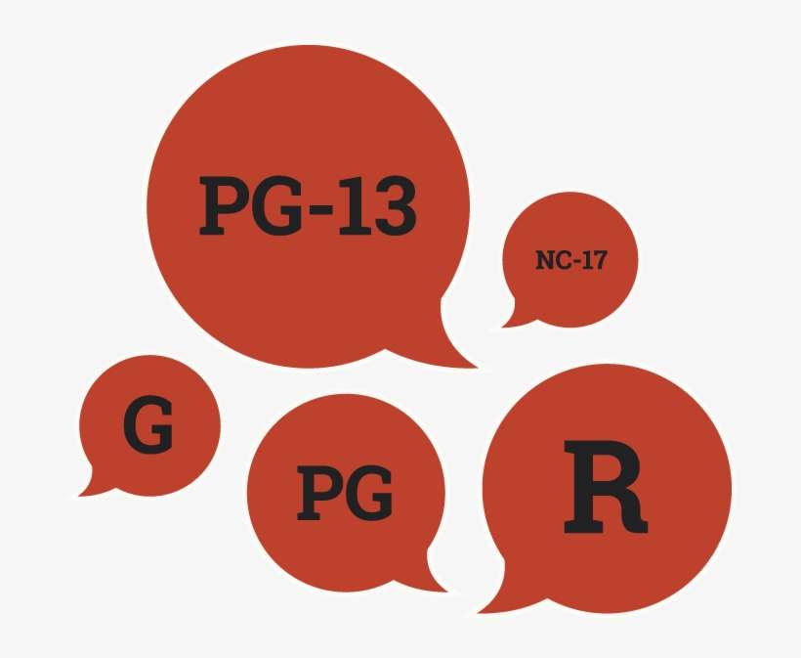
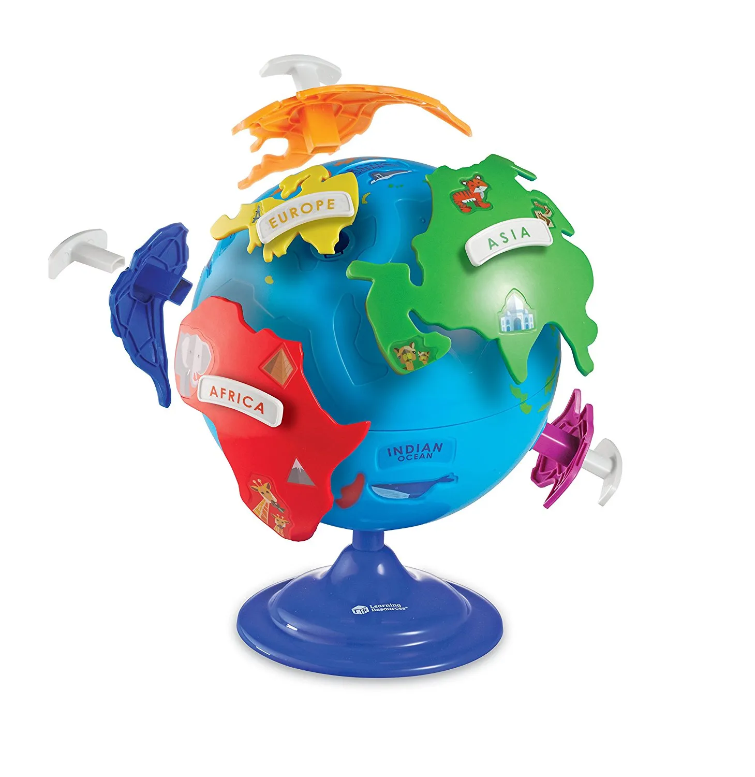
Business Profile Overview
599 Customers
20
Film Category
1000
Film title
Action
Animation
Children
Classics
Comedy
Documentary
Drama
Family
Foreign
Games
Horror
Music
New
Sci-Fi
Sports
Travel
Thriller
Crime
Romance
War
5
Ratings
108 Countries

Slide 5

Which movies contributed the most/least to revenue gain?
Movies with the highest revenue
Movies with the lowest revenue
Rank | Title | Total amount
1 | Ridgemont Submarine | $ 3,542.57
2 | Apache Divine | $ 3,506.73
3 | Forward Temple | $ 3,442.83
4 | Bucket Brotherhood | $ 3,434.92
5 | Pulp Beverly | $ 3,420.00
6 | Harry Idaho | $ 3,410.97
7 | Rugrats Shakespeare | $ 3,398.17
8 | Massacre Usual | $ 3,390.43
9 | Network Peak | $ 3,388.05
10 | Rocketeer Mother | $ 3,379.99
Rank | Title | Total amount
1 | Mixed Doors | $410.02
2 | Hardly Robbers | $424.92
3 | Mannequin Worst | $441.86
4 | Fever Empire | $471.88
5 | Bunch Minds | $476.85
6 | Train Bunch | $476.97
7 | Informer Double | $492.79
8 | Traffic Hobbit | $500.77
9 | Seven Swarm | $507.78
10 | Braveheart Human | $524.80

Slide 6

What was the average rental duration for all videos?
5 Days
(AVG rental duration for all movies)
$2.94
(AVG rental fee for all movies)
AVG rental duration per rating
Rating | Avg rental duration (Days)
G | 4.8
PG | 5
PG-13 | 5
R | 4.8
NC-17 | 5

Slide 7
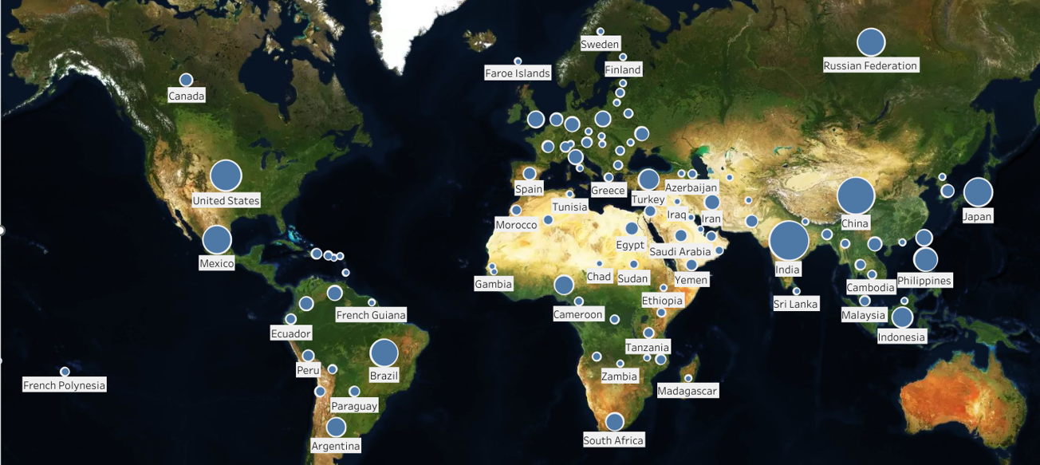
Do sales figures vary between geographic regions?
Rockbuster has customers in almost 108 countries.
The more the population, the more revenue company makes.
The Map represents all the countries and sizes based on the customer count.

Slide 8
Do sales figures vary between geographic regions?
Top 10 countries based on customer counts
Country | Customer counts | Total payment
India | 60 | $ 6,035
China | 53 | $ 5,251
United States | 36 | $ 3,685
Japan | 31 | $ 3,123
Mexico | 30 | $ 2,985
Brazil | 28 | $ 2,919
Russian Federation | 28 | $ 2,766
Philippines | 20 | $ 2,220
Turkey | 15 | $ 1,498
Indonesia | 14 | $ 1,353
With the highest population between countries, we can see that India & China have vary difference among other countries for both customer number & revenue.

Slide 9
Where are the top cities & customers located?
TOP 5 CUSTOMERS
WITHIN THE TOP 10 CITIES OF THE TOP 10 COUNTRIES
TOP 10 Cities
WITHIN THE TOP 10 COUNTRIES
First name | Last name | Country | City | Total payment
Arlene | Harvey | India | Ambattur | 111.76
Kyle | Spurlock | China | Shanwei | 109.71
Marlene | Welch | Japan | Iwaki | 106.77
Carla | Gutierrez | India | Bhusawal | 103.74
Glen | Talbert | Mexico | Acua | 100.77
Country | City | Customer counts
Mexico | Acua | 1
Brazil | So Leopoldo | 1
Japan | Iwaki | 1
India | Ambattur | 1
India | Kanchrapara | 1
India | Dhule (Dhulia) | 1
India | Bhusawal | 1
China | Shanwei | 1
China | Tianjin | 1
China | Hami | 1

Slide 10
Thank You
Hazem Elnady
Hazem.elnady84@gmail.com
Business Intelligence Dep.

